Slide 1
Lecture 2: Introduction to Relational Model
Notes:
1

Slide 2
The Relational Model
Three basic components:
Relations (Tables):
Logical data structures to store data
Integrity constraints:
Rules to enforce that the data is (and remains) consistent over time
Enforce that the database will be in a perfect condition at all times
Operations:
Operations to manipulate data

Slide 3
The Relational Model: Relations
A Relation is a Table (or entity set)
A Relation consists of:
Columns ➔ attributes
Rows ➔ entity occurrences
Each row represents an occurrence in the entity
Example: instructor table contains information about a group of instructors
A relation is structure-independent and data-independent
Notes:
3

Slide 4
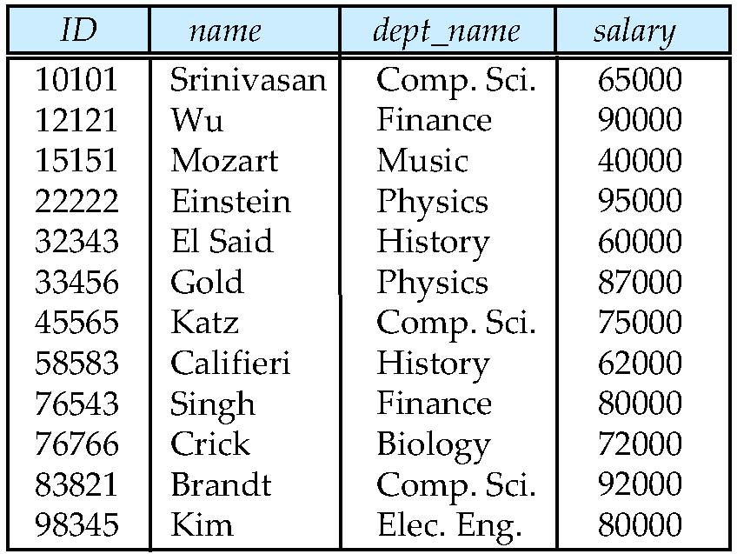
Example of a Relation
attributes
(or columns)
tuples
(or rows)
Notes:
4

Slide 5
Relations (Cont’d)
A relation is made up of 2 parts:
Relation Schema:
Structure of the table
Order of columns in the relation is not important
Example:
instructor(
ID: string,
name: string,
Dept_name: string,
salary: real)
Relation Instance: A table filled with contents (or data)

Slide 6
attribute
ID
name
dept_name
salary
53666
mozart
Music
65000
53688
Smith
History
tuple
90000
53650
Smith
Math
40000
Schema:
instructor (ID: string, name: string, dept_name: string, salary: real)
Relation Characteristics:
Cardinality ➔ Number of Rows
Degree ➔ Number of Attributes
Cardinality = 3
Degree = 4
Are tuples distinct? Why or why not?

Slide 7
Columns (Attributes)
Relation schema defines a set of columns
Each column has the following characteristics:
Name:
each column should have a distinct name
Data type:
all values in the column must have the same data type
Numeric, string, date, logical
Example:
name ➔ string
salary ➔ real number
Attribute domain:
The set of allowed values for each attribute
Example: 30000 < salary < 150000
Attribute values are (normally) required to be atomic; that is, indivisible

Slide 8
NULL values
NULL is a database value that is used to fill in a cell in the table that has no value:
An unknown attribute value
A missing attribute value
Examples:
salary of a certain instructor is not available at the time of data entry
home Phone number might not exist for some people
A “not applicable” condition
A NULL value is not a zero or space

Slide 9
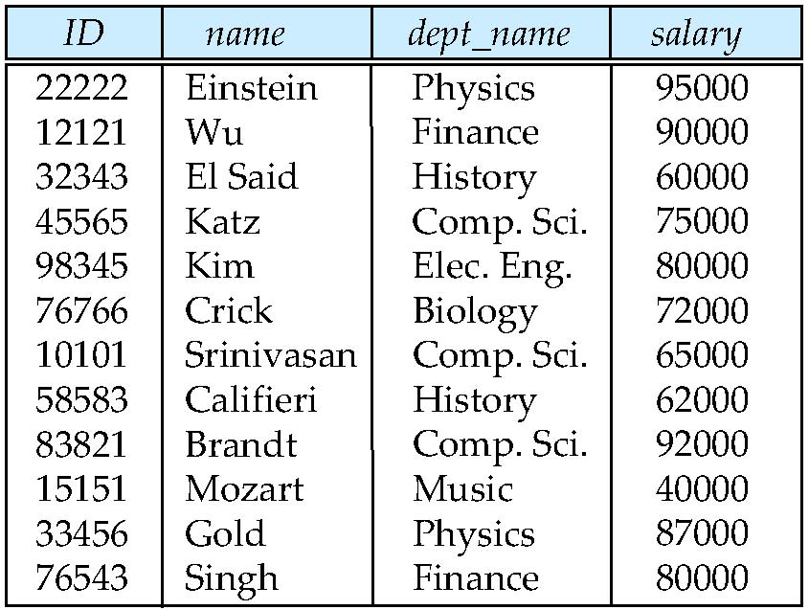
Relations are Unordered
Order of tuples is irrelevant (tuples may be stored in an arbitrary order)
Example: instructor relation with unordered tuples
Notes:
9

Slide 10
Database
A database consists of multiple relations
Example: Information about a university is broken up into three relations
instructor, student , advisor
Bad design:
univ (instructor_ID, name, dept_name, salary, student_Id)
Results in:
Repetition of information (e.g., two students have the same instructor)
The need for null values (e.g., represent a student with no advisor)
Normalization theory (Chapter 7) deals with how to design “good” relational schemas
Notes:
10

Slide 11
Database Schema
The term "schema" refers to the organization of data as a model of how the database is constructed (divided into database tables in the case of relational databases).
In relational database, it is the grouping of relations (tables), enforced by relationship rules (integrity constraints)
Relations also depict relationship connectivity (1:1, 1:M, M:M) – covered later in the course
Notes:
11

Slide 12
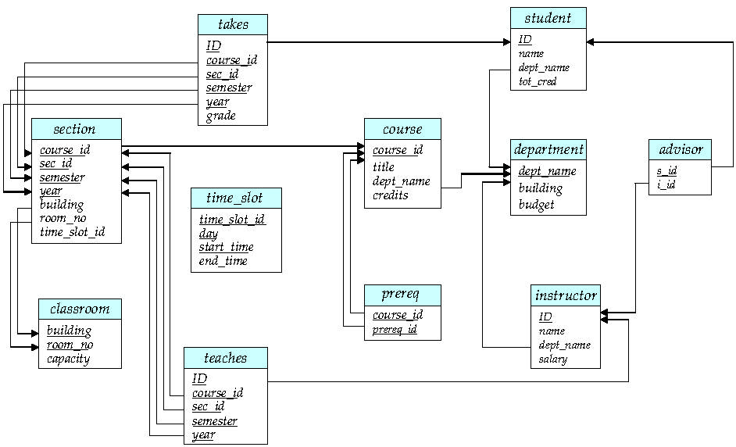
Schema Diagram for University Database

Slide 13
Primary Key Constraint
Each relation should have a Primary Key (PK)
A PK ensures that each row in the table is uniquely identifiable
Example: ID is the primary key for the relation instructor because each instructor must have a unique identifier
A PK determines other attributes
A determines B (A→B)
If you know the value of A, you can determine the value of B
Example: ID ➔ name, dept_name, salary
Can we use dept_name as the PK?
If dept_name is “History”, can you determine instructor name? Can you determine salary?

Slide 14
Composite key
A composite key is a primary key that consists of more than one attribute
Example: classroom relation
Primary key consists of two attributes:
building
room_no
Can building determine capacity?
No, because different rooms in the building differ in capacity
Can room_no determine capacity?
No, because two rooms may have same number but in different buildings are not the same
Both building + room_no can determine capacity!

Slide 15
Composite Key (continued)
The PK for the relation takes consists of five attributes:
student identifier (ID)
course identifier (course_id)
sec_id
semester
year
ID only cannot determine a single grade value
A student has more than one grade in more than one course
course_id only cannot determine a single Grade value
A course has more than one student
(ID, course_id, sec_id, semester, year) is a Composite Key
ID,course_id, sec_id,semester,year ➔ grade
Pronounced: ID,course_id, sec_id, semester,and year determines grade

Slide 16
Other types of keys
Super key:
Any key that uniquely identifies each row
Example:
Both (ID) and (ID, name) are super keys for the instructor table
However, name is an unnecessary attribute in the key
Candidate key:
Minimal super key (i.e., a super key without unnecessary attributes)
An attribute that can be a primary key but it is not selected to be a primary key
Example: A login attribute can be a candidate key
A primary key is a super key is a candidate key

Slide 17

Foreign key
A Foreign key is used to represent the relationship between two tables
student
takes
S_ID | name | dept_name | tot_cred
53666 | Jones | CS | 34
53688 | Smith | Music | 70
53650 | Smith | CS | 110
T_ID | course_id | grade
53666 | CS101 | A
53666 | CS102 | B
53650 | CS102 | A
A foreign key is an attribute whose value matches the primary key of a related table:
T_ID is a foreign key in the takes table
Only students that have ID are allowed to enroll in courses
Notes:
17

Slide 18
Foreign key (continued)
A foreign key has two parts:
Referencing relation
Referenced relation
Example: In the University Database
Referencing Relation | Foreign Key | Referenced Relation
takes | ID | student
instructor | dept_name | department
prereq | course_id | course

Slide 19
Keys: Summary
Primary key:
A candidate key that is selected to uniquely identify each row in the table
Cannot be NULL
Composite key:
A key that consists of more than one attribute
Super key:
An (attribute or a set of attributes) that Uniquely identifies each row in the table
Candidate key:
A minimal super key (does not contain unnecessary attributes)
Foreign key:
An attribute or set of attributes in one table whose value refer to an attribute in another related table

Slide 20
The Relational Model: Integrity Constraints
Integrity constraints are rules that need to be enforced by the DBMS to ensure that the data will be always in a perfect condition
Integrity constraints are divided into three categories:
Domain Constraint:
Specify the range of values that can be used in a column
Entity Integrity
Can the data be uniquely identified?
Referential Integrity
Can data in one table be uniquely identied based on value in another table?

Slide 21
Entity Integrity
A Primary Key uniquely identifies each row
A primary key is NOT NULL
A composite primary key cannot have NULL in any of its fields

Slide 22
Referential integrity
A foreign key must refer to the primary key of another table
Value of the foreign key attribute either:
Matches a value from the other table’s primary key
Is NULL:
Example:
A course might not have an instructor assigned but can not have an invalid instructor ID

Slide 23
Checking Entity Integrity
instructor table has ID attribute as the primary key column:
No null entries
All entries are unique

Slide 24
Exercise
For the instructor table below, there are no two instructors with the same name. Can we conclude that name can be used as the PK for the instructor table?

Slide 25
Schema Diagram for University Database

Slide 26
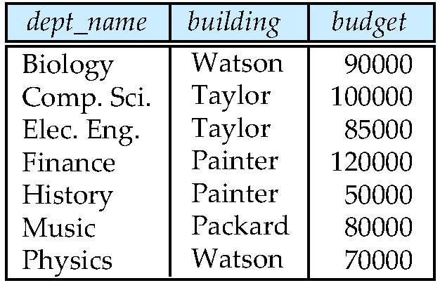
Checking Referential Integrity
instructor table has the attribute dept_name as a foreign key:
Represents the 1:M relationship between department and instructor
All instructors’ dept_name values are valid values from the PK attribute (dept_name) in department table
Department
Instructor

Slide 27
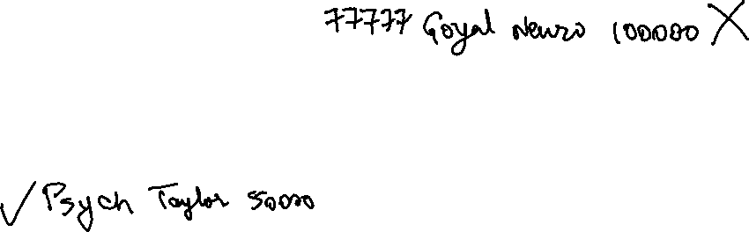
Exercise
Given the following instructor and department tables, give examples of some insertion and deletion operations that could violate the referential integrity constraint.
Department
Instructor

Slide 28
Summary of Integrity Constraints
Entity Integrity:
Primary key constraint
Unique, Not NULL
Each row in the table has a unique identity
Referential Integrity:
Foreign key constraint
A foreign key on a table refers to the primary key of another table or NULL
Domain Constraint:
Specify the range of values that can be used in a column

Slide 29
Where do ICs Come From?
Integrity constraints are extracted from Business rules
One can check a given database instance to see if an IC is violated
Example:
We can verify that the name is not a key
But, the assertion that ID is a key should be given to us.
Notes:
29

Slide 30
The Relational Model: Operations
Relational Query Languages (e.g., SQL) are used for: manipulation and retrieval of data from a database.
A query is composed of one or more relational operations
There are six basic relational operators:
Select
Project
Union
Set-difference
Cartesian Product
Natural Join

Slide 31
Why Operations?
Operations are used to answer queries over the relational database.
Example queries:
List names of all Physics instructors
List names of all instructors who have salary > 70000
List names of all instructors who work in “Taylor” building

Slide 32
Relational Query Language
RQLs are Declarative:
Users describe what they want, rather than how to compute it.
Query Languages != programming languages
QLs are not intended to be used for complex calculations
QLs support easy, efficient access to large data sets

Slide 33
Types of Relational Query Languages
Relational Algebra:
Formal query language
Defines a set of operations on relations depicting usual algebra operations as add, subtract, multiply
SQL:
Practical language used by DBMS
Relational Algebra is the formal model upon which SQL is based

Slide 34
Types of Relational Operators
Unary Op
Binary Op

Slide 35

Characteristics of Relational Operators
Closure property:
A relational operator takes relations as input and produces a relation as output
The schema of the result of a given query can be extracted from the query
Composition property:
Operations can be composed:
Output of one operation can be used as the input for another operation
Unary Op
Binary Op

Slide 36
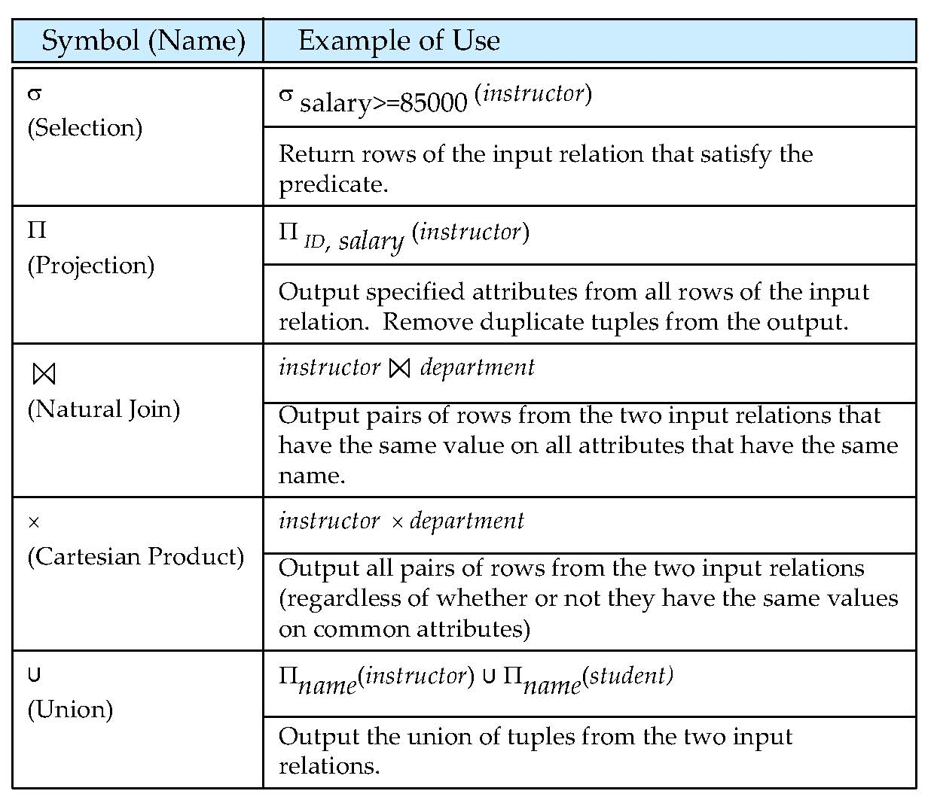
Figure 2.1
Notes:
36

Slide 37
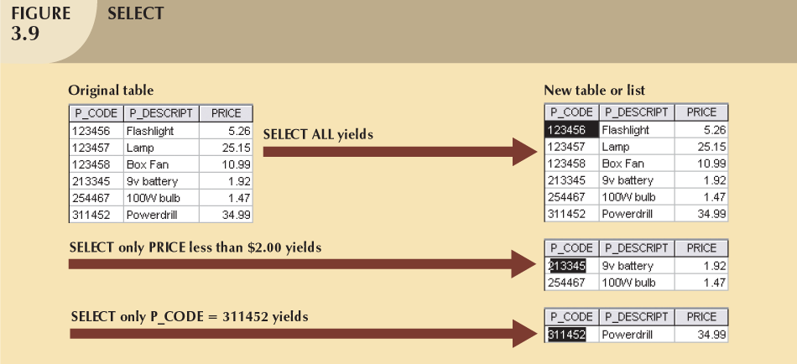

1 - Select (σ)
Unary operation σ(A)
Finds rows in a table that satisfy a given condition
σ _{PRICE < 2}(R)
σ _{P_CODE = 311452}(R)
Gives a horizontal subset of the table
Schema of output relation is identical to the schema of the (only) input relation.
37

Slide 38
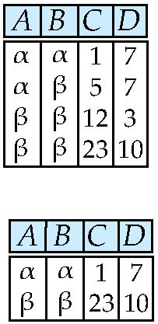
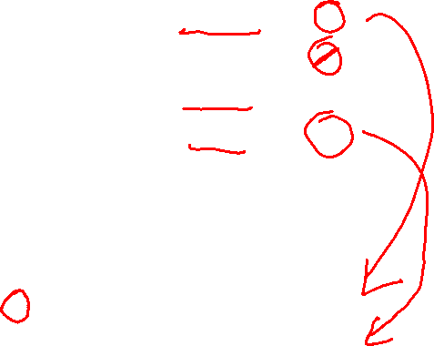
Selection of tuples
Relation r
Select tuples with A=B and D > 5
σ _{A=B and D > 5} (r)
Notes:
38

Slide 39
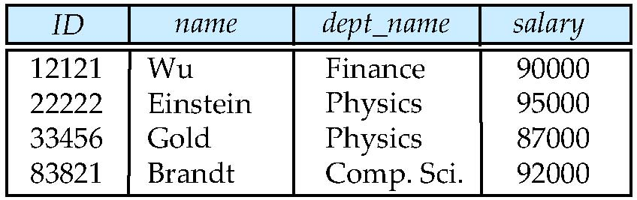

Select instructors with salary greater than $85000
σ _{salary > 85000}(instructor)
➔
Notes:
39

Slide 40
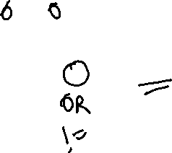
Class Exercise on Select
Select Instructors who work in Physics department
Select Instructors who work in Physics department, and whose salary is more than 90000
σ _{dept_name=“Physics”}(instructor)
σ dept_name=“Physics” and salary > 90000 (instructor)

Slide 41
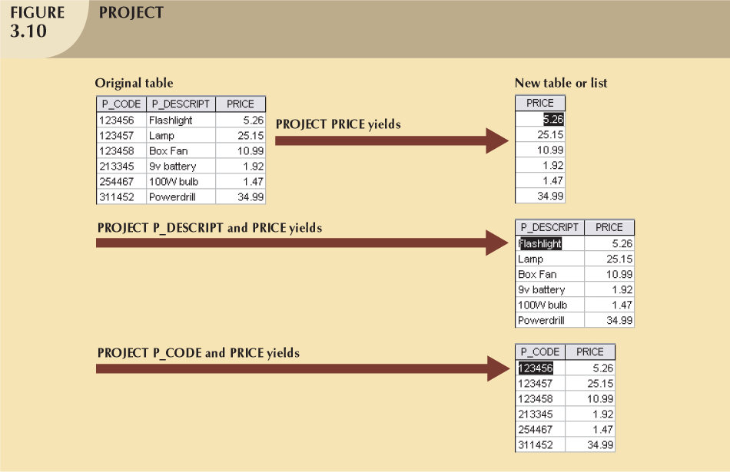

2 - Project (π)
Unary operation π (A)
Finds specific set of attributes
π_{Price}(R)
π_{P_CODE,PRICE}(R)
Vertical subset of the table
Schema of the output relation consists of the attributes in the projection list
41

Slide 42
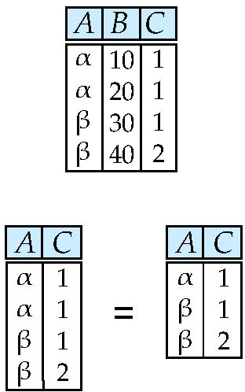

Selection of Columns (Attributes)
Relation r:
Select A and C
Projection
Π _{A, C} (r)
Notes:
42

Slide 43
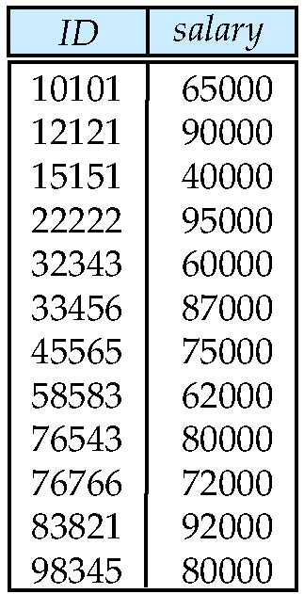

Select ID and salary from table instructor
Π_{ID,salary} (instructor)
➔

Slide 44

Selection + Projection
Query: Find name and grade of students with grade > 8.
STUDENT
ID | name | grade | age
28 | yuppy | 9 | 35
31 | lubber | 8 | 55
44 | guppy | 5 | 35
58 | rusty | 10 | 35
Input
Output ?
Notes:
44
8

Slide 45


S_name | S_grade
yuppy | 9
rusty | 10
Output
Π_{name, grade} (instructor)
Project(name, grade)
id | name | grade | age
28 | yuppy | 9 | 35.0
58 | rusty | 10 | 35
σ_{grade > 8} (instructor)
Select (grade> 8)
id | name | grade | age
28 | yuppy | 9 | 35
31 | lubber | 8 | 55
44 | guppy | 5 | 35
58 | rusty | 10 | 35
Input

Slide 46
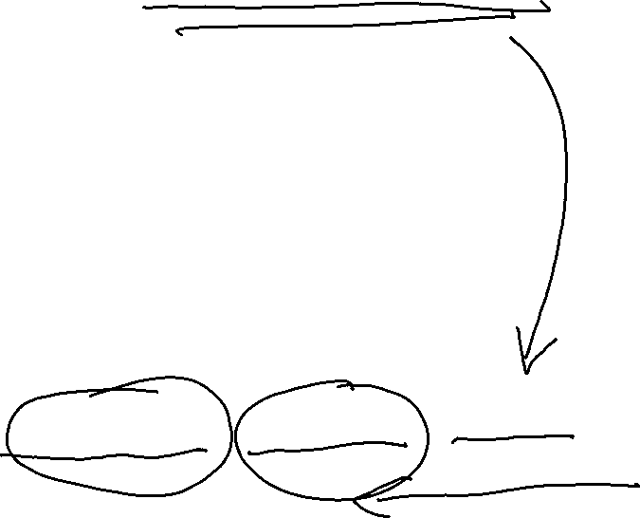
Selection + Projection
σ_{grade > 8} (instructor)
+
Π_{name, grade} (instructor)
=
Π_{name, grade} ( σ_{grade > 8} (instructor))

Slide 47

Class Exercise
Write the relational algebra expressions for the following query:
Find the names of all instructors in the physics department
∏name (σ _{dept_name=} = “Physics”(instructor))

Slide 48
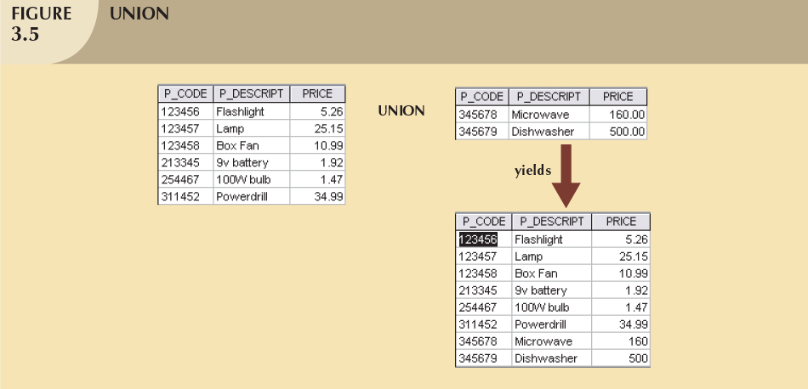

3- Union
Combines all rows from two tables
Union-compatible
The two input tables should have the same schema
Attributes and domains should be identical
Excludes duplicate rows
48

Slide 49
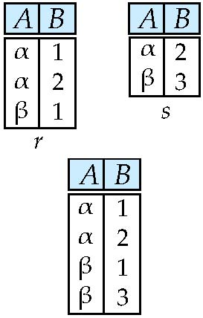
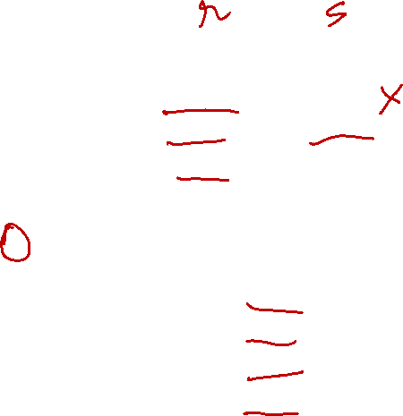
Union of two relations
Relations r, s:
r ∪ s:
Notes:
49

Slide 50
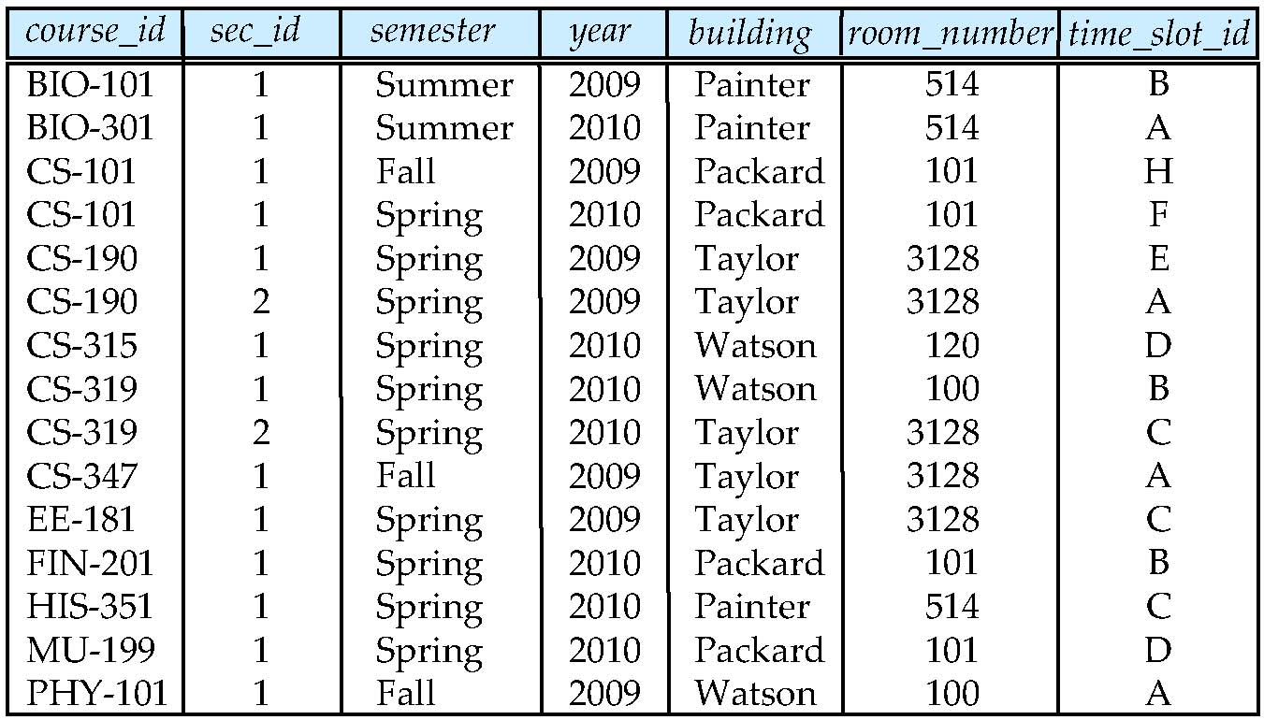

Example
Given the below section table, write a query to find the course_id of all courses taught in Fall 2009, Spring 2010, or both.

Slide 51
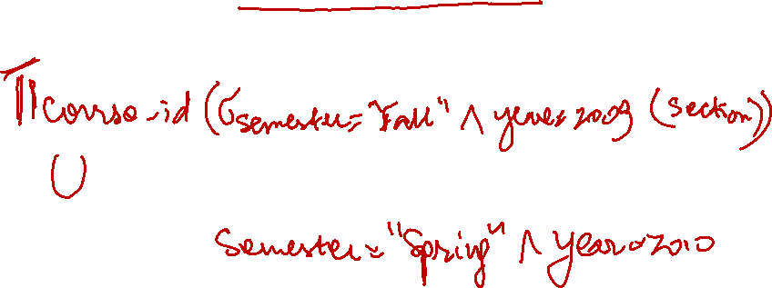
Example
Given the below section table, write a query to find the set of all courses taught in Fall 2009, Spring 2010, or both. Let’s solve this question!

Slide 52
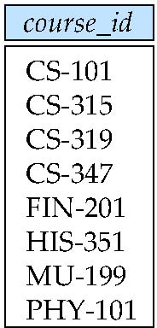

Solution
∏_{course_id} (σ _{semester=“Fall” Λ year=2009} (section))
∪ ∏_{course_id} (σ _{semester=“Spring” Λ year=2010} (section))

Slide 53
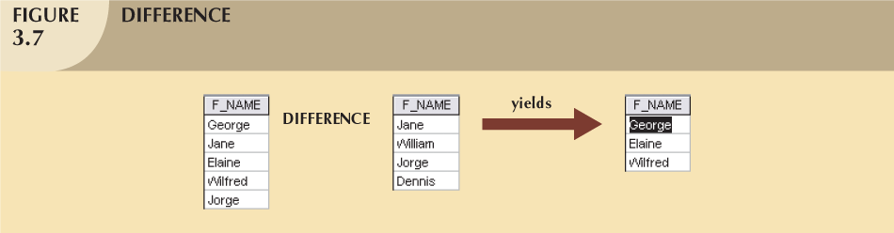

4- Set-difference
All rows in left table that are NOT in the right table
Input tables must be union-compatible
53

Slide 54
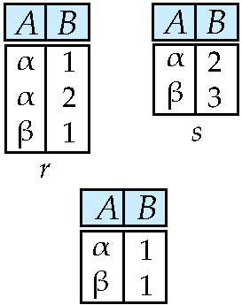

Set difference of two relations
Relations r, s:
r – s:
Notes:
54

Slide 55
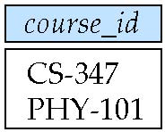

Example
Find all courses that are taught in Fall 2009 but not in Spring 2010
∏_{course_id} (σ _{semester=“Fall” Λ year=2009} (section))
- ∏_{course_id} (σ _{semester=“Spring” Λ year=2010} (section))

Slide 56
Union & Set-difference
Binary operations:
Takes two relations as input
The input relations should be union-compatible
Schema of the output relation is the same as the input relations

Slide 57

5- Cartesian product
Allows us to combine information from any two relations
Finds all possible pairs of rows from the two tables:
Concatenations of every possible two rows
Binary operation
If R has 6 rows, S has 3 rows:
RXS has 18 rows
Schema of the output relation is the concatenation of the two input relations

Slide 58
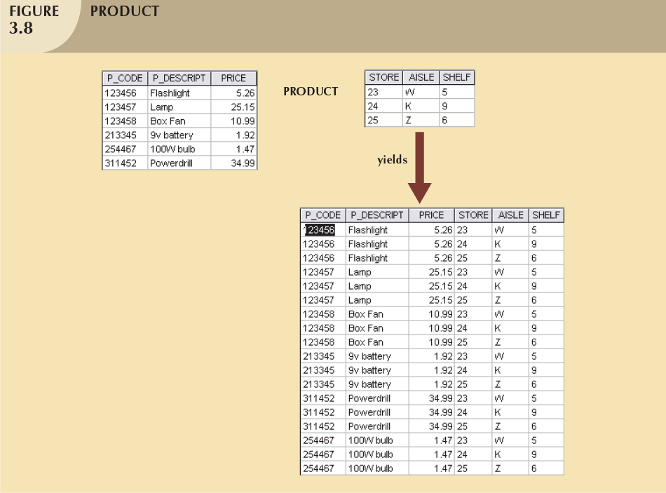
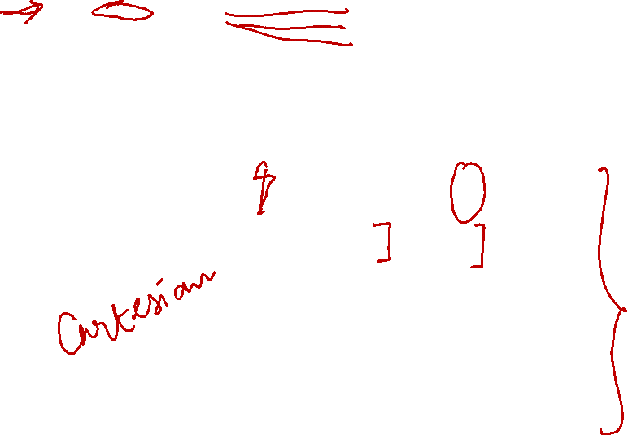
58

Slide 59
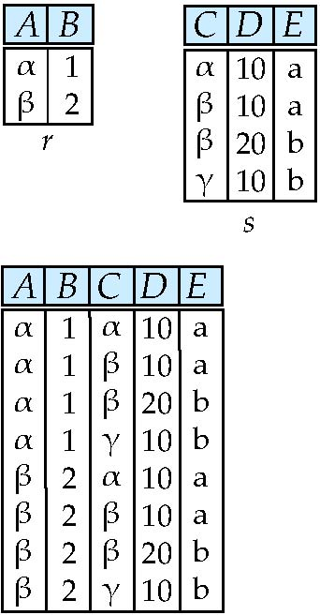

Cartesian Product
Relations r, s:
r x s:
Notes:
59

Slide 60
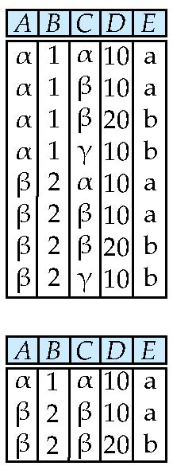

Composition of Operations
Can build expressions using multiple operations
Example: σ_{A=C}(r x s)
r x s
σ_{A=C}(r x s)
Notes:
60

Slide 61

Example
Find the names of all instructors in the Physics department, along with the course_id of all courses they have taught
Instructor
ID
dept_name
name
Teaches
ID
course_id
Solution 1:
∏_{Name,course_id} (σ_{dept_name=“Physics”} (σ _{instructor.ID=teaches.ID} (instructor x teaches)))
Solution 2:
∏_{Name,course_id} (σ_{instructor.ID=teaches.ID} (σ _{dept_name=“Physics”} (instructor) x teaches))
Notes:
61

Slide 62
Schema Diagram for University Database

Slide 63
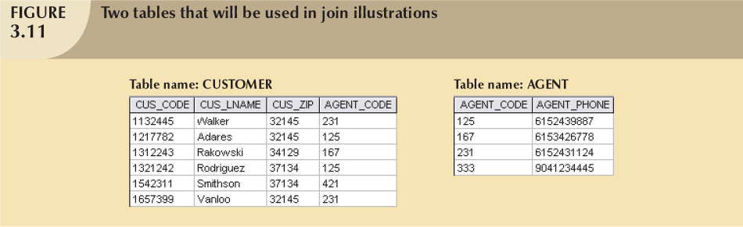

6- Join
Binary operation
Combine information from two tables
The real power behind relational databases
63

Slide 64
Natural Join
Natural Join:
Links tables by selecting rows that have common values in their common attributes
Schema of the output is same as that of cross-product.
Natural Join produces fewer tuples than cross-product

Slide 65
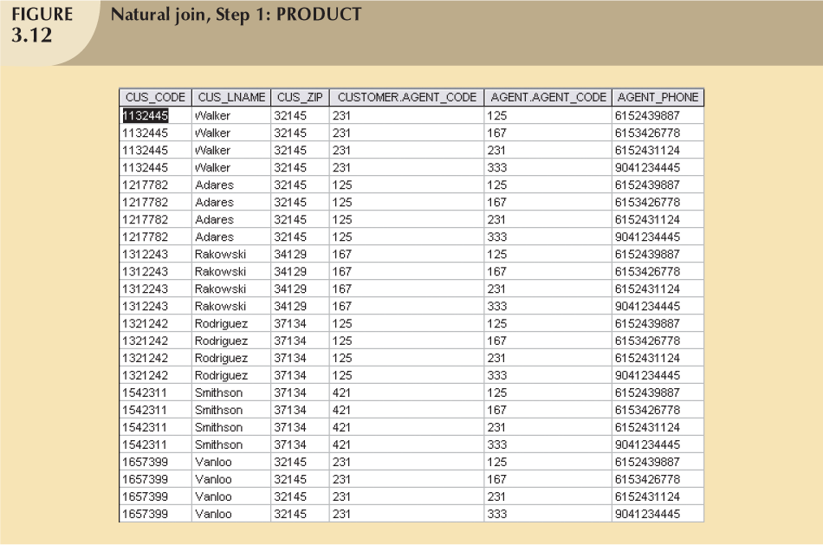

Select where
CUSTOMER.AGENT_CODE = AGENT.AGENT_CODE

Slide 66
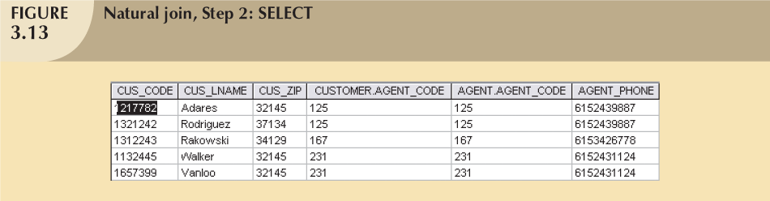
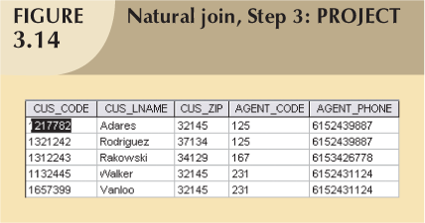

Slide 67
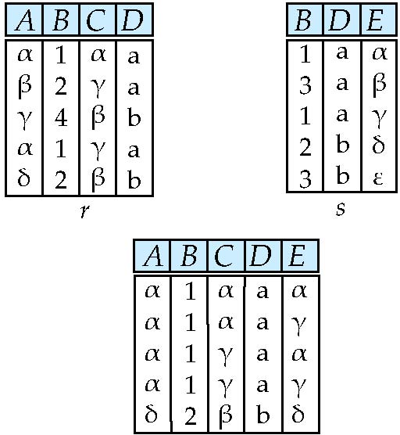

Natural Join Example
Relations r, s:
Natural Join
r s
Notes:
67

Slide 68

Natural Join Continued
What is the output of the natural join of the instructor and department table
Instructor department
Notes:
68

Slide 69
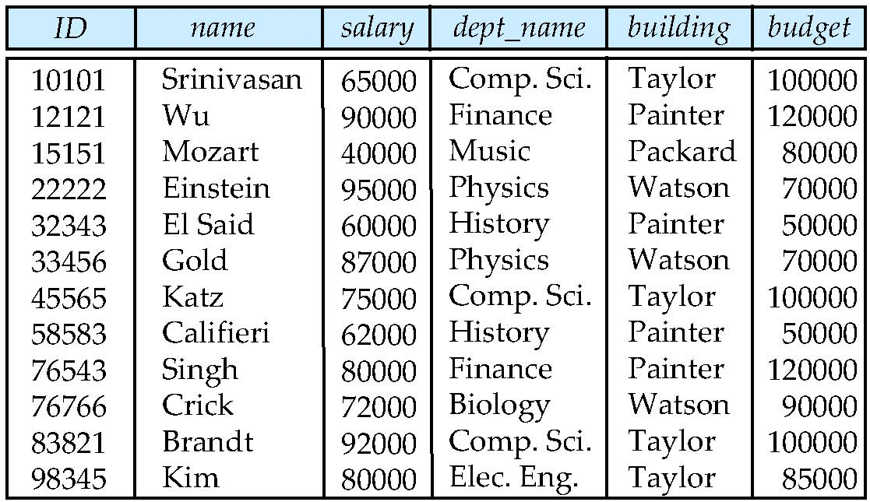
Natural Join Continued
Instructor department

Slide 70
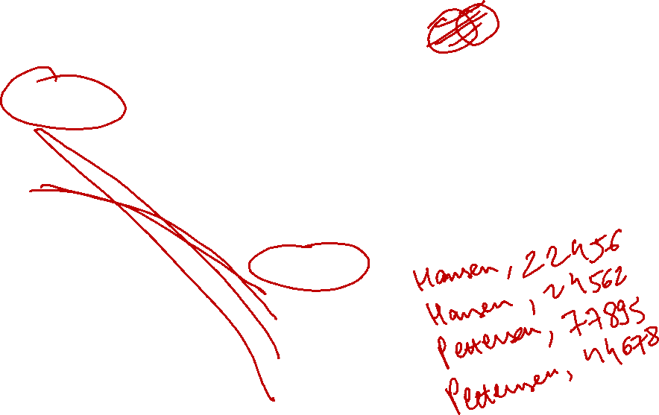
Natural Join Continued
Persons
PersonID | LastName | FirstName | Address | City
1 | Hansen | Ola | Timoteivn 10 | Sandnes
2 | Svendson | Tove | Borgvn 23 | Sandnes
3 | Pettersen | Kari | Storgt 20 | Stavanger
Orders
O_Id | OrderNo | PersonID
1 | 77895 | 3
2 | 44678 | 3
3 | 22456 | 1
4 | 24562 | 1
5 | 34764 | 15
JOIN condition ( Persons.PersonID = Orders.Person_ID ) OUTPUT?

Slide 71
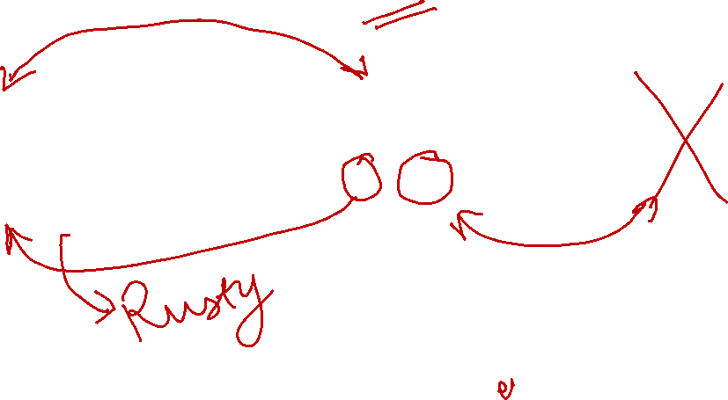
Find names of sailors who’ve reserved boat #103
sailors
reserves
boats
bid
Color
101
Red
103
Green
Notes:
71
16

Slide 72

sname
rusty
Solution
Output
Project(sname)
sid | bid | day | sanme | rating | age
58 | 103 | 11/12/1996 | rusty | 10 | 35
Natural Join
sid | bid | day
58 | 103 | 11/12/1996
Select (bid = 103)
sid | sname | rating | age
22 | dustin | 7 | 45
31 | lubber | 8 | 55
58 | rusty | 10 | 35
sid | bid | day
22 | 101 | 10/10/1996
58 | 103 | 11/12/1996
Reserves
Sailors

Slide 73
Solution: Relational Algebra Expression
π_{sname}(σ_{bid=103}(reserves sailors)

Slide 74
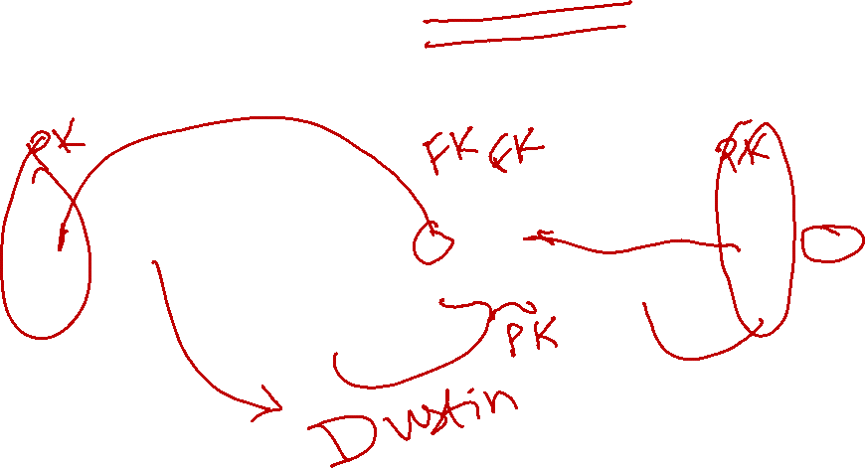
Exercise: Find names of sailors who’ve reserved a red boat
sailors
reserves
boats
bid
Color
101
Red
103
Gree
n
Notes:
74
17

Slide 75
Schema Diagram for University Database

Slide 76
Exercise
Considering the University database, explain in words the output of the below relational algebra expressions :
σ_{year>2009}(takes student)
π_{ID,name,course_ID}( student takes)

Slide 77
Reading and Assignment

